Slide 1

Notes:
https://www.npr.org/sections/alltechconsidered/2018/05/28/614419275/do-not-sell-my-personal-information-california-eyes-data-privacy-measure
Protection of personal data is an extremely hot topic nowadays. Whether we like it or not, our personal data is out there and is being exploited in an unlimited number of ways. Each and every one of our digital footprints grows by the day, and our behavior is being predicted like never before. Gone are the days where we are embarrassed about our internet search history, or even the days where we worried about privacy of highly sensitive information like social security numbers and credit card numbers because of the Equifax data breach. It’s become way more personal as we ask ourselves if our phones are listening to us, or if Alexa was developed as an in-home spy as opposed to an in-home speaker.
We’re all aware of the very public personal data privacy class action lawsuits involving Facebook and Cambridge Analytica, but this is just the tip of the iceberg. With more and more stigma generated surrounding the exploit of personal user data, my team an I sought an alternative approach to predict online user activity, specifically within eCommerce.

Slide 2

Predicting Online Purchase Intention
Using Browser Session Data
Sachin Balakrishnan | Apoorv Mehrotra
Akankshi Mody | Jacob Padden | Grant Zhong
Notes:
https://pixabay.com/en/macbook-apple-imac-computer-screen-606763/
Hi, I’m Jacob, and these are my teammates Sachin, Apoorv, Akankshi, and Grant, and we attempted to predict online purchase intention using personalized browser session data as opposed to sensitive user data.

Slide 3

DATASET
DESCRIPTION

Slide 4
Dataset Description
12,330 sessions
1-year period
10 numerical attributes
8 categorical attributes

Slide 5
Level of Data - Browser Session
A set of hits triggered by a user
A hit is a user interaction (pageview, screenview, event, transaction) that sends data to GA server (GIF Request)
A user can generate >1 sessions in a day

Slide 6
Dataset Attributes
Revenue
Administrative
Administrative Duration
Informational
Informational Duration
Product Related
Product Related Duration
Exit Rate
Bounce Rate
Page Value
11. Special Day (duration between
the order date and delivery date)
12. Weekend
13. Month of the year
14. Operating system
15. Browser
16. Region
17. Traffic type
18. Visitor type (returning or new visitor)
Notes:
The 'Revenue' attribute can be used as the class label.
"Administrative", "Administrative Duration", "Informational", "Informational Duration", "Product Related" and "Product Related Duration" represent the number of different types of pages visited by the visitor in that session and total time spent in each of these page categories. The values of these features are derived from the URL information of the pages visited by the user and updated in real time when a user takes an action, e.g. moving from one page to another.
The "Bounce Rate", "Exit Rate" and "Page Value" features represent the metrics measured by "Google Analytics" for each page in the e-commerce site.
The value of "Bounce Rate" feature for a web page refers to the percentage of visitors who enter the site from that page and then leave ("bounce") without triggering any other requests to the analytics server during that session.
The value of "Exit Rate" feature for a specific web page is calculated as for all pageviews to the page, the percentage that were the last in the session.
The "Page Value" feature represents the average value for a web page that a user visited before completing an e-commerce transaction.
The "Special Day" feature indicates the closeness of the site visiting time to a specific special day (e.g. Mother’s Day, Valentine's Day) in which the sessions are more likely to be finalized with transaction. The value of this attribute is determined by considering the dynamics of e-commerce such as the duration between the order date and delivery date. For example, for Valentina’s day, this value takes a nonzero value between February 2 and February 12, zero before and after this date unless it is close to another special day, and its maximum value of 1 on February 8.
The dataset also includes operating system, browser, region, traffic type, visitor type as returning or new visitor, a Boolean value indicating whether the date of the visit is weekend, and month of the year.
Each session has PageValue, which is the average of all PageValues that the user visited during the session
Each session has ExitRate, which is the average of all ExitRates that the user visited during the session
Each session has BounceRate, which is the average of all BounceRates that the user visited during the session

Slide 7
CLASSIFICATION
MODELS

Slide 8
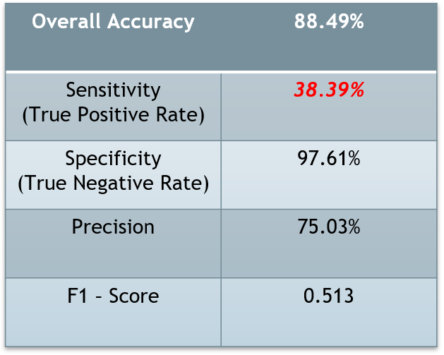
Logistic Regression
Binary Classification Problem.
Dependent Variable - Whether the user will generate revenue for the website?
Seventeen predictor variables – 10 numeric and 7 categorical.
12330 observations
Overall Accuracy
88.49%

Slide 9
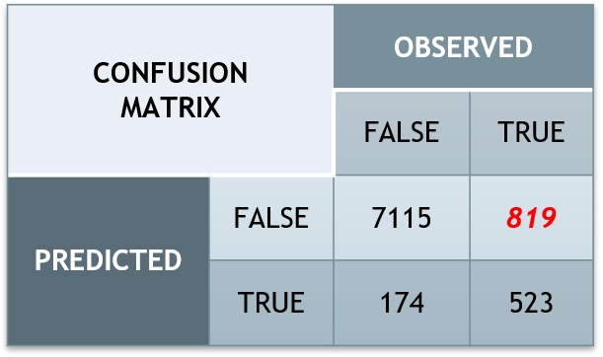
Model Performance – NOT GOOD !
Skewed Dependent variable.
Ratio of Positive to Negative Observations – 85% to 15%
Always predict FALSE – you got 85% accuracy !!!
Too many FALSE NEGATIVES
LOW AUC - 0.683
Overall Accuracy
88.49%

Slide 10

Resampling Methods
Down-Sampling
Under-sample the majority class instances from the training data
Up-Sampling
Duplicate the minority instances in the training data
SMOTE
Synthetic Minority Oversampling Technique
Nearest neighbour approach to draw artificial samples
ROSE
Random Over-Sampling Examples
Smoothed bootstrapping to draw artificial samples from feature space
Notes:
https://pixabay.com/en/chairs-conference-room-long-table-1840377

Slide 11
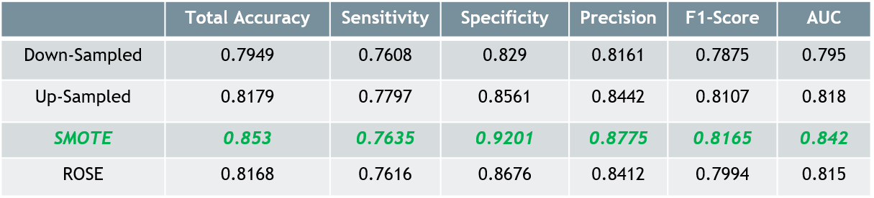
Resampling with 10 fold CV
SMOTE yielded the best results in-terms of accuracy and AUC value.

Slide 12
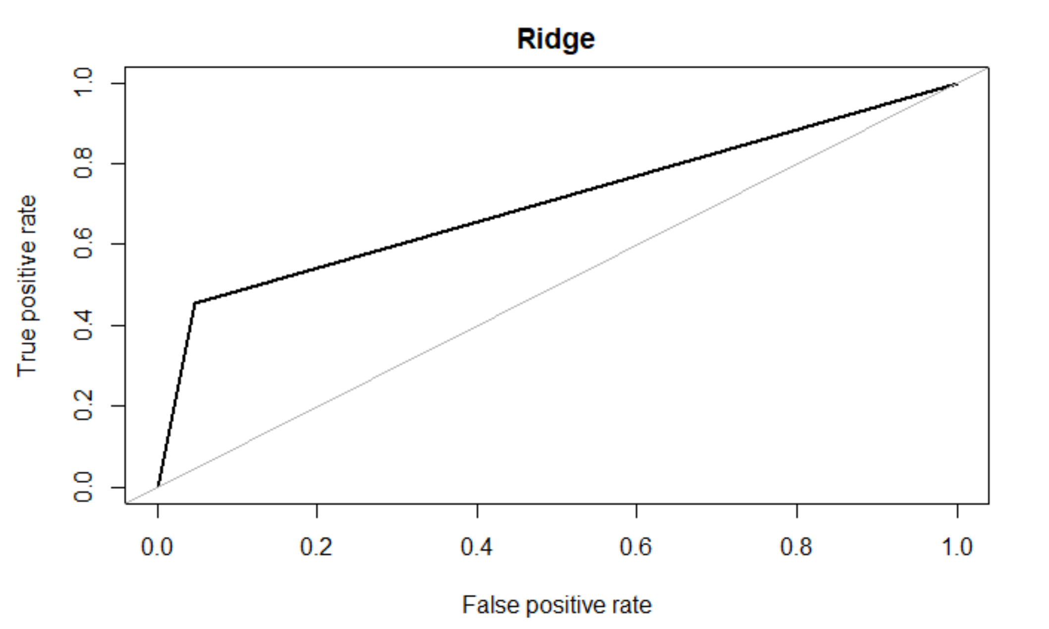
Ridge Regression
Using SMOTE Resampling
Min Lambda | 0.0247
Accuracy | 0.872
Sensitivity | 0.456
Specificity | 0.953
Precision | 0.656
F1 Score | 0.538
AUC | 0.705

Slide 13
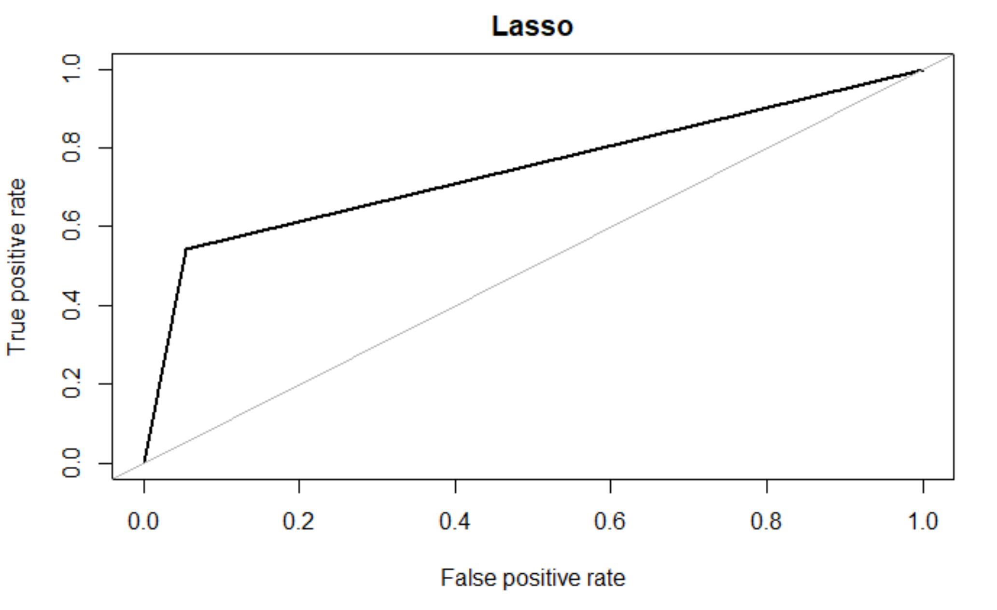
Lasso Regression
Using SMOTE Resampling
Min Lambda | 0.00058
Accuracy | 0.879
Sensitivity | 0.544
Specificity | 0.945
Precision | 0.659
F1 Score | 0.596
AUC | 0.744

Slide 14
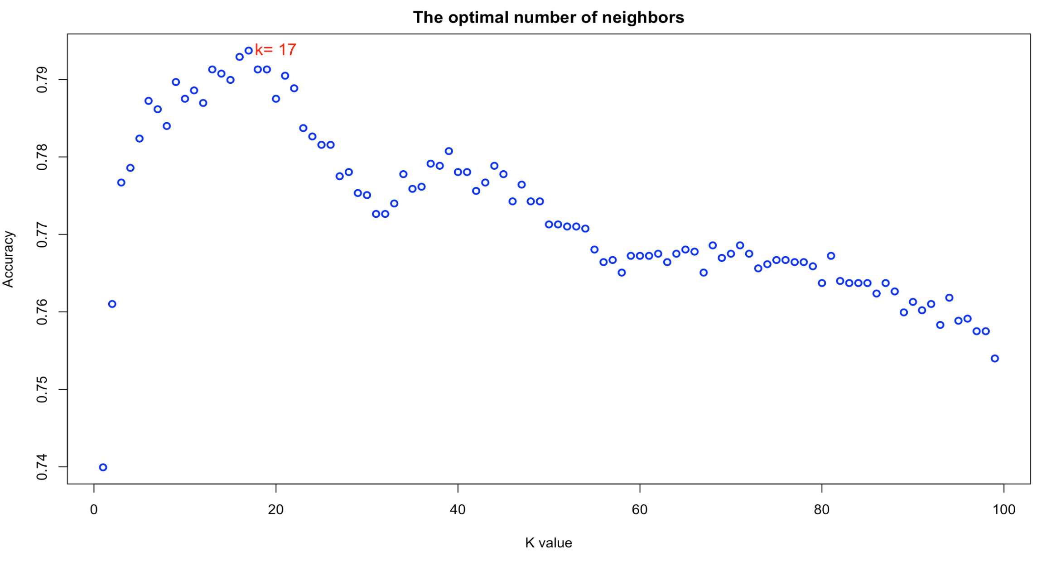
K-Nearest Neighbor w/ SMOTE
k=17 gave highest
accuracy
10 Fold CV with SMOTE Resampling
Accuracy | 0.793
Sensitivity | 0.389
Specificity | 0.928
Precision | 0.389
F1 Score | 0.478
Notes:
We used the KNN approach for classification in order to determine whether an online shopper will result in revenue for the company based on a set of factors. We chose to try KNN because it is a simple yet powerful algorithm for classification. Furthermore, we have limited knowledge on how each column of factors were calculated so choosing a model that makes no generalizations about the data was important to make good predictions based on feature similarity.
After we determined the optimal k value for nearest neighbors, we performed 10-fold cross validation with the SMOTE training data set and here are our results. We were able to achieve an overall accuracy of 0.793 with a F1 score of 0.478.

Slide 15
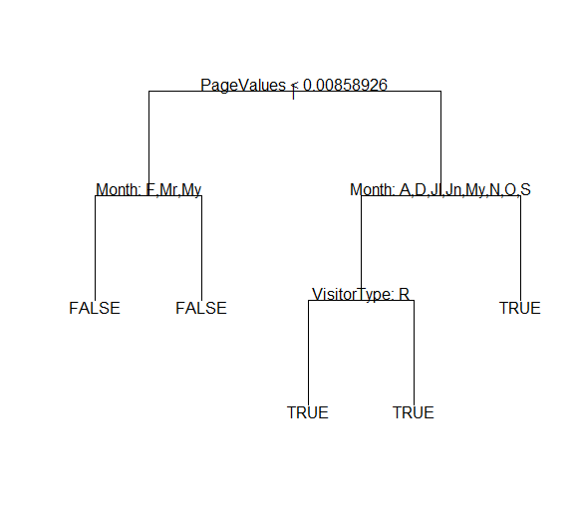
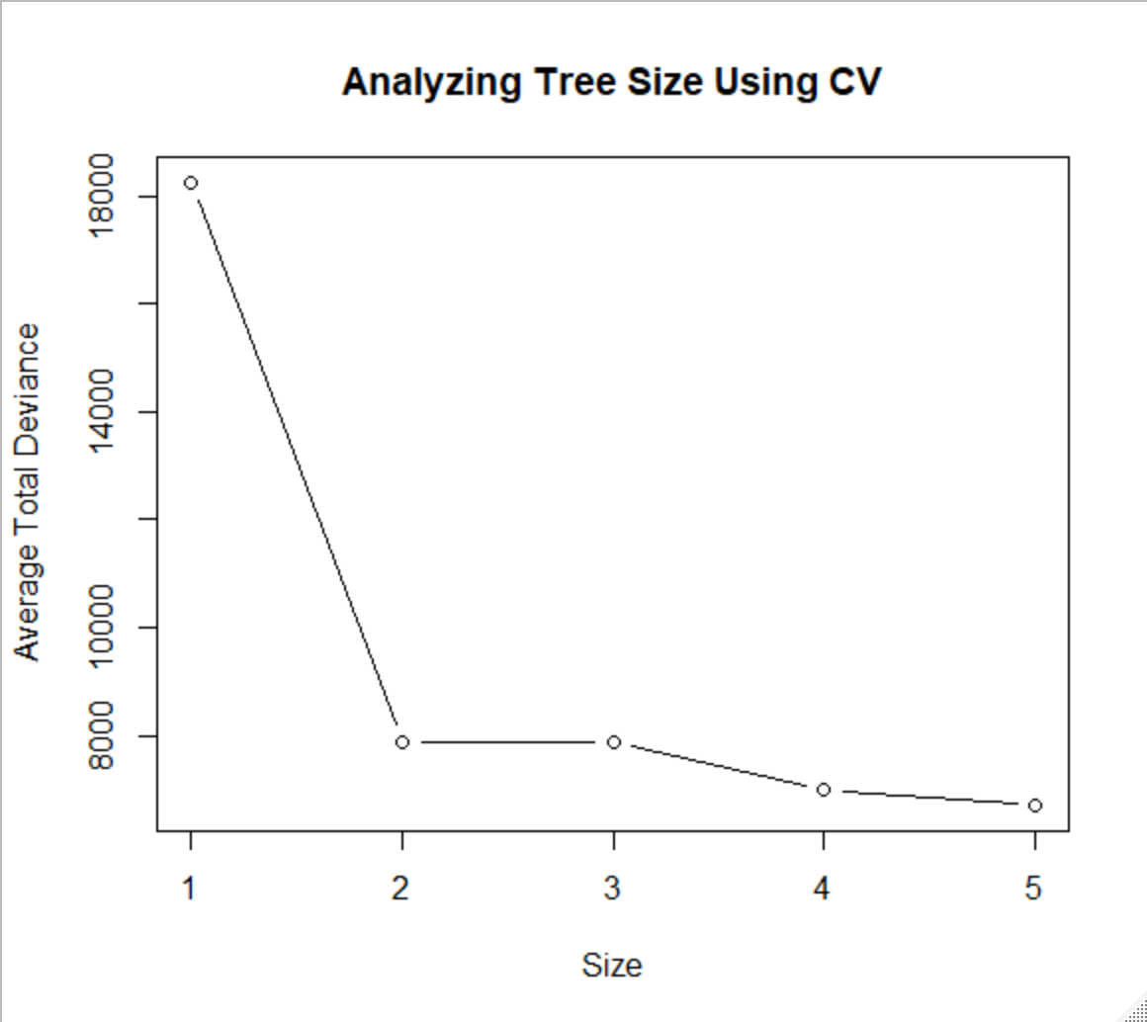
Decision Tree
PageValues extremely important!
10 Fold CV with SMOTE Resampling
Accuracy | 0.876
Sensitivity | 0.785
Specificity | 0.893
Precision | 0.575
F1 Score | 0.662
AUC | 0.839
Other variables fine tune probabilities

Slide 16
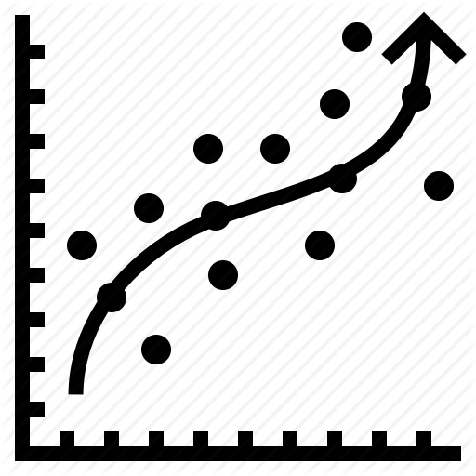
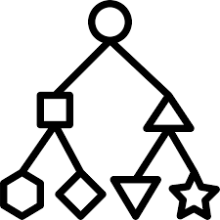
Random forest - 2 approaches
Regression
Classification
Tune for mtry
Tune for cutoff
Compare metrics
Check variable importance
Tune for mtry
Compare metrics
Check ROC
Check variable importance

Slide 17
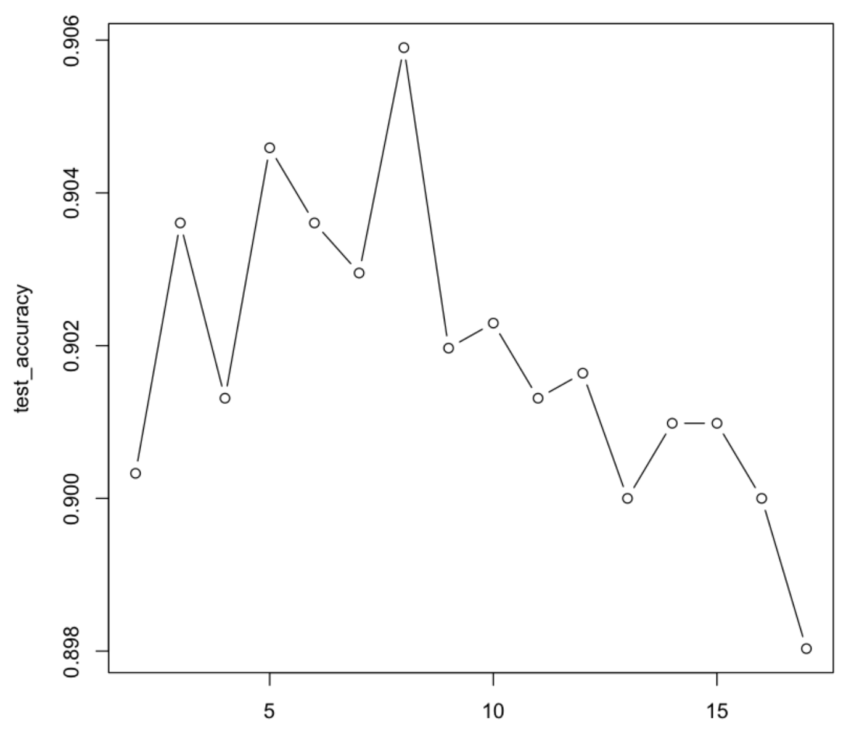
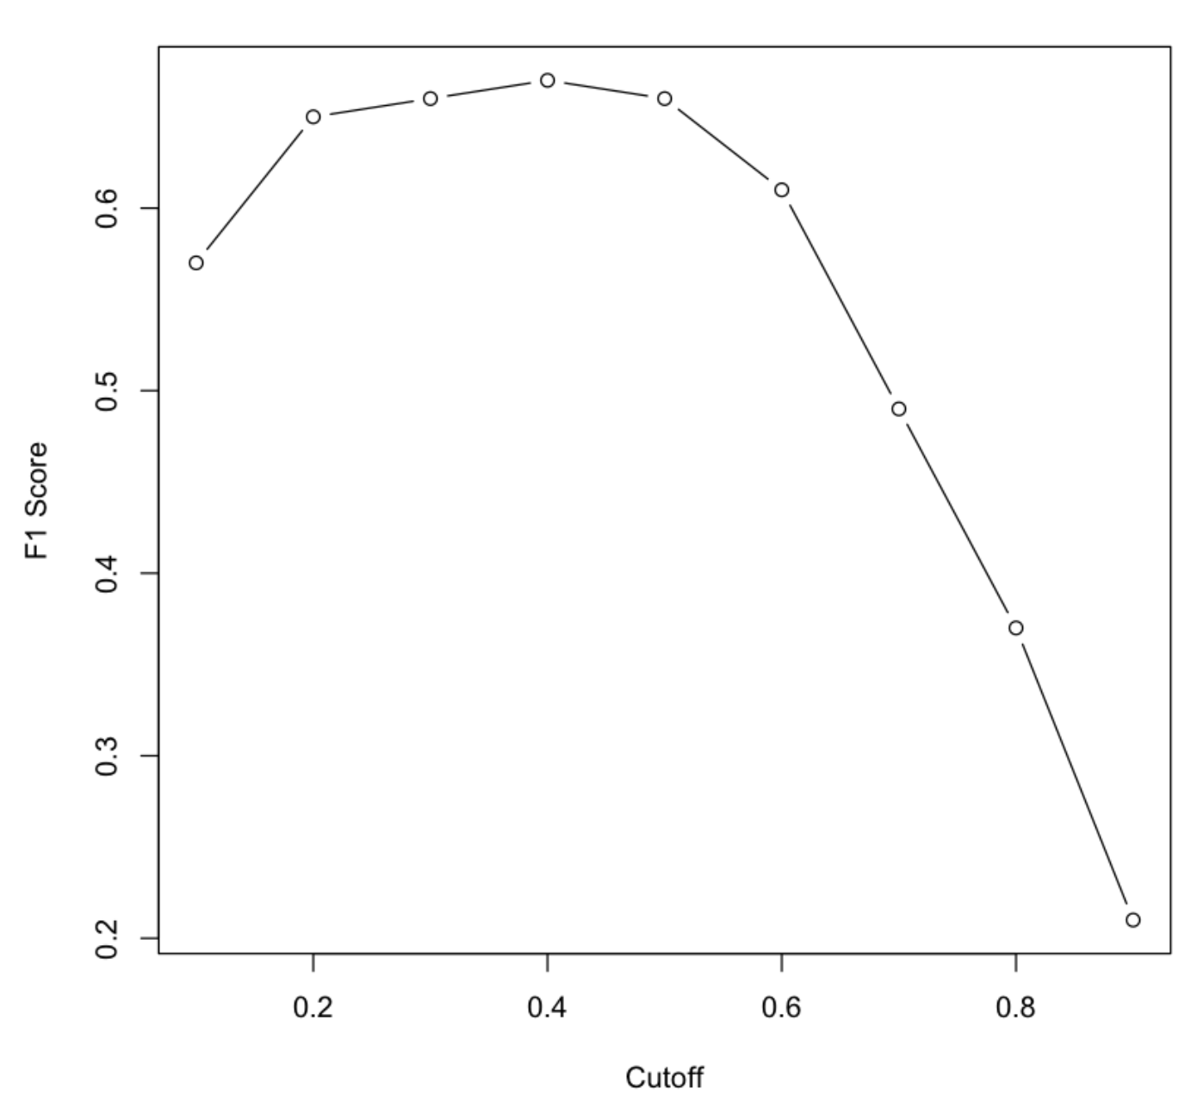
Random forest - Regression
mtry=8
cutoff=0.4
Accuracy | Sensitivity (Recall) | Specificity | Precision | F1-Score
0.89 | 0.68 | 0.94 | 0.66 | 0.67

Slide 18
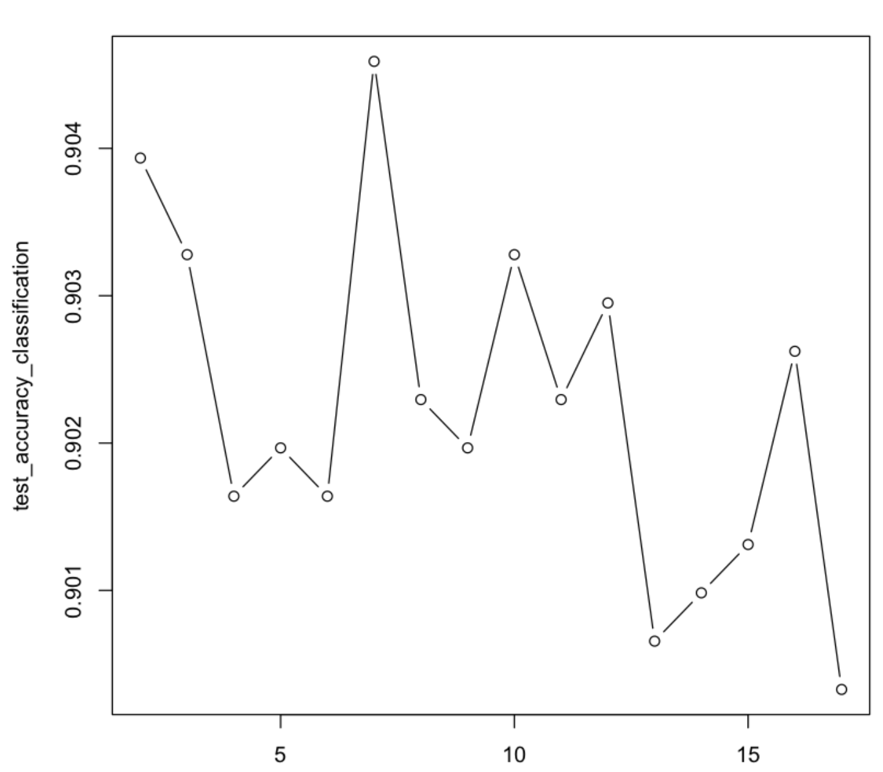
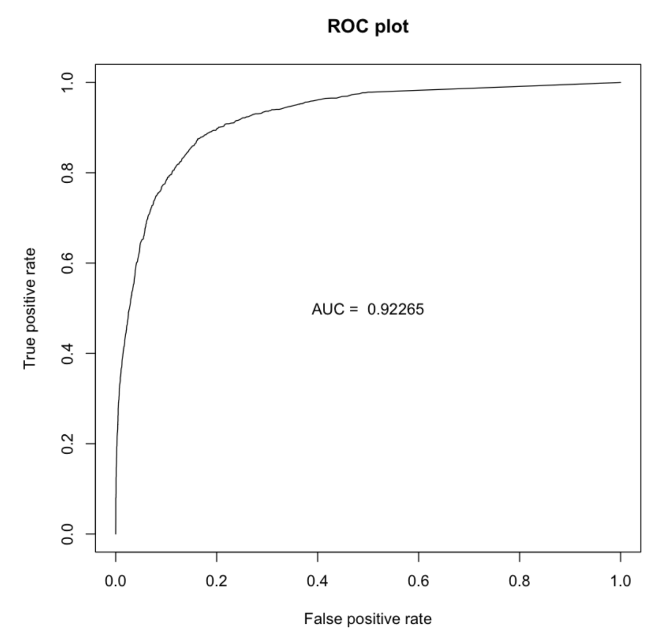
Random forest - Classifier
mtry=7
Accuracy | Sensitivity (Recall) | Specificity | Precision | F1-Score | AUC
0.904 | 0.63 | 0.95 | 0.71 | 0.66 | 0.922

Slide 19
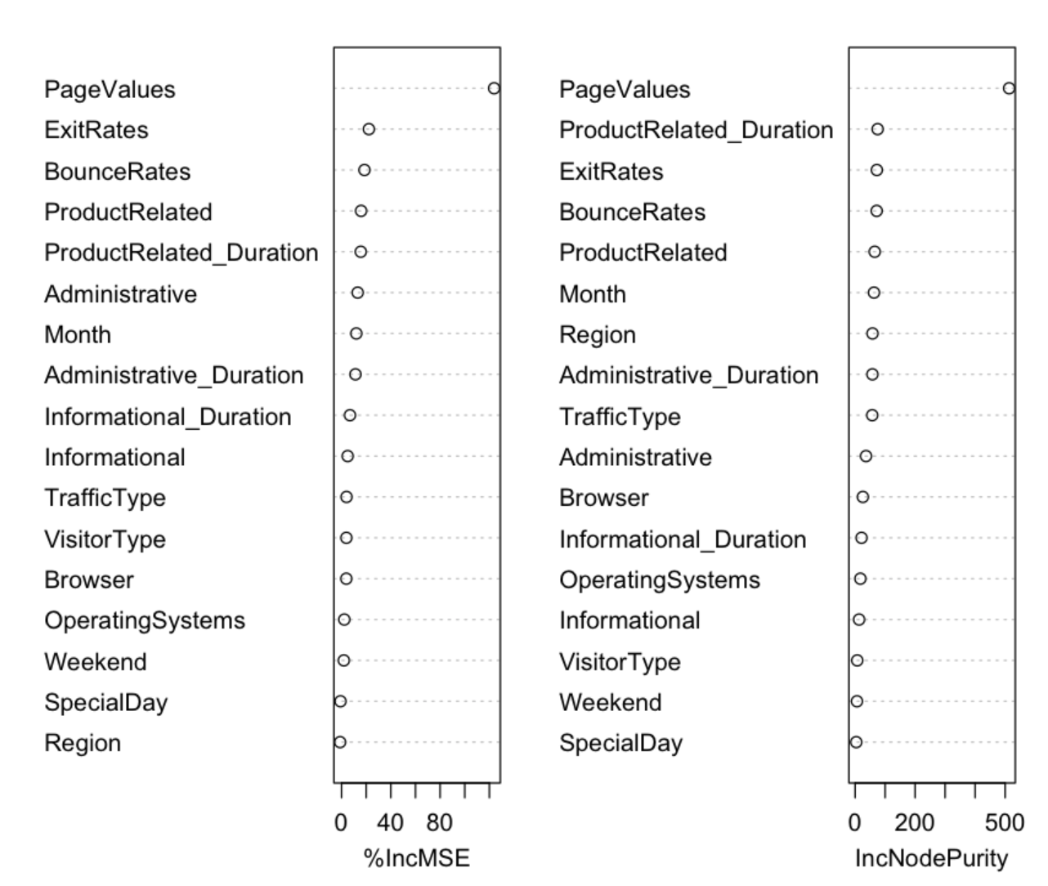
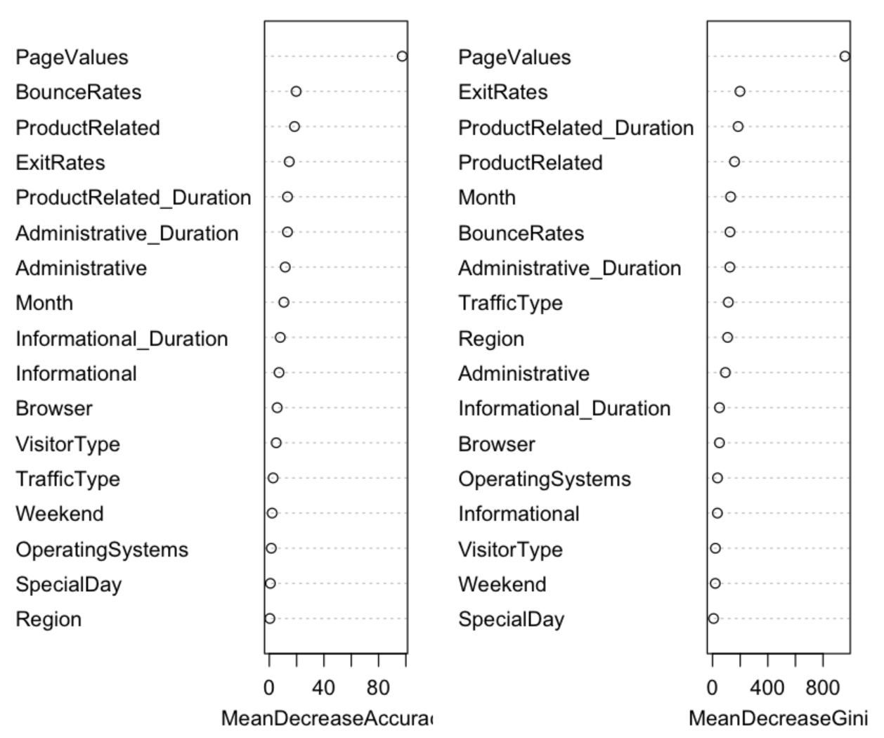
Random forest - Important Variables
Regression
Classification

Slide 20
CONCLUSION

Slide 21
Model Selection
Model | Accuracy | F1 Score
Logistic Regression | 0.88 | 0.82
Random Forest | 0.89 | 0.67
Decision Tree | 0.88 | 0.66
LASSO Regression | 0.88 | 0.60
Ridge Regression | 0.87 | 0.54
KNN | 0.79 | 0.48

Slide 22
Thanks for Watching
We hope you enjoyed watching the presentation as much as we enjoyed making it.

Slide 23
QUESTIONS?

Slide 24
Acknowledgments
C. Okan Sakar Department of Computer Engineering, Faculty of Engineering and Natural Sciences, Bahcesehir University, 34349 Besiktas, Istanbul, Turkey
Yomi Kastro Inveon Information Technologies Consultancy and Trade, 34335 Istanbul, Turkey
Source: https://www.kaggle.com

Slide 25
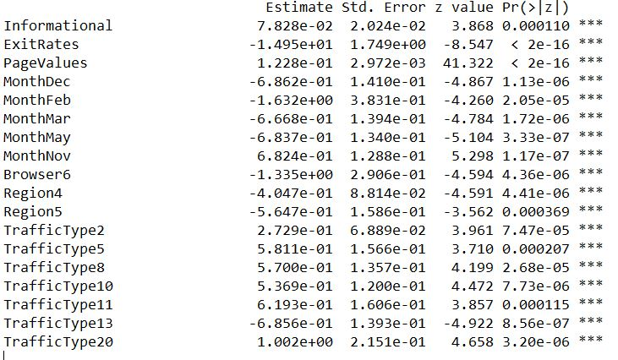
Appendix

